Slide 1

Malware for Windows: DLL Injection
Rob Shovan 10/27/2025

Slide 2


whoami
Cybersecurity Engineer @ MITRE
Red teaming/Offensive focus
Active Cyber Defense Assistant Instructor
Red teamer for CDE
Previous VP and Team Captain
BS IS 2022
MS CYBR 2027

Slide 3

Just a quick reminder…
Don’t Do Crime
The tools and techniques we will be going over can be applied to misuse a system/network​
Unless it is YOUR server, computer, virtual machine, or service, or unless you have EXPLICIT and COMPLETE permission to do so…​
DO NOT USE ANY OF THESE TOOLS OR TECHNIQUES ON A SYSTEM FOR WHICH YOU DON’T HAVE COMPLETE AUTHORIZATION TO DO SO​
If you don’t adhere to this, some of the legal ramifications include - but are not limited to-the following:​
Expulsion from UMBC​
Being charged for either a misdemeanor or a felony, depending on the severity​
Fines up to $100,000 for misdemeanors, up to $250,000 for felonies​
Jail time up to 1 year for misdemeanors, up to 10 years for felonies​
AND THIS IS JUST THE FEDERAL LEVEL.​

Slide 4

DLL? EXE? PE??
Who has heard of these terms?

Slide 5


DLL? EXE? PE??

Slide 6
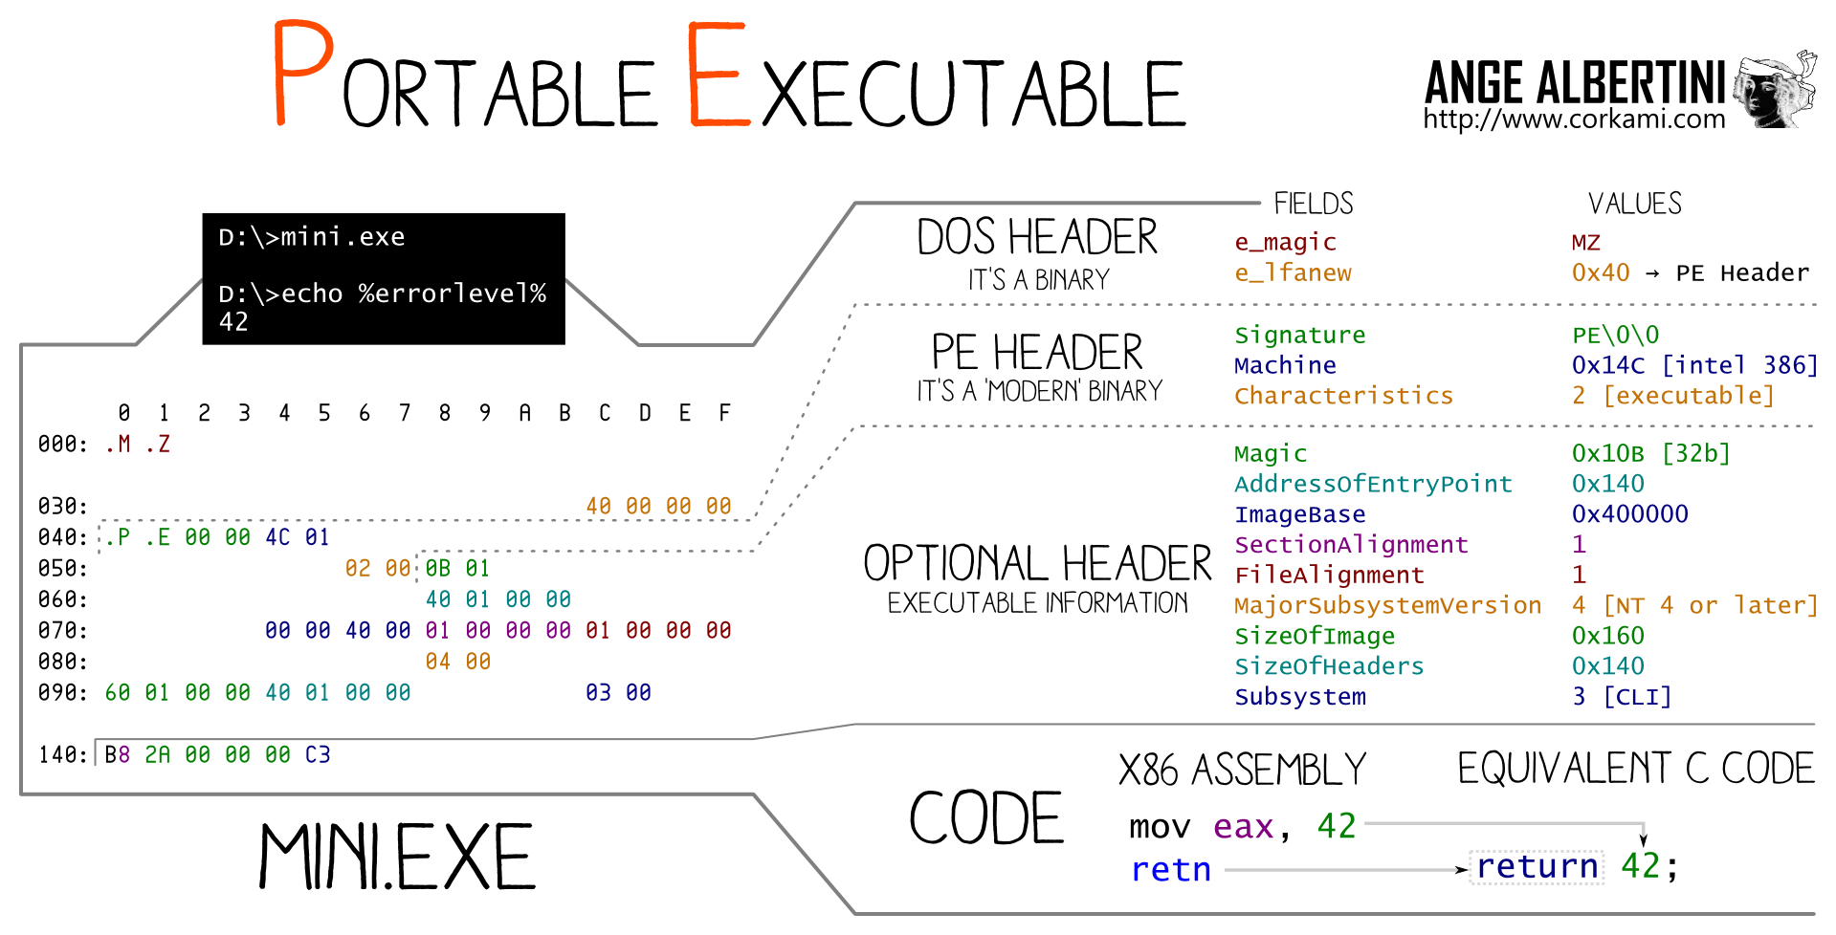
DLL? EXE? PE??

Slide 7
DLL? EXE? PE??

Slide 8

DLL? EXE? PE??
EXE vs DLL?

Slide 9
DLL? EXE? PE??
EXE
Standalone executable application/code
DLL
Non-standalone executable code
Needs to be called by something else
DLL is just code external of an exe
Main functions are different
Loaded by loader or during runtime

Slide 10

What is DLL Injection?

Slide 11
What is DLL Injection?
“DLL injection is commonly performed by writing the path to a DLL in the virtual address space of the target process before loading the DLL by invoking a new thread.”
https://attack.mitre.org/techniques/T1055/001/

Slide 12

What is DLL Injection?
“DLL injection is commonly performed by writing the path to a DLL in the virtual address space of the target process before loading the DLL by invoking a new thread.”
https://attack.mitre.org/techniques/T1055/001/

Slide 13
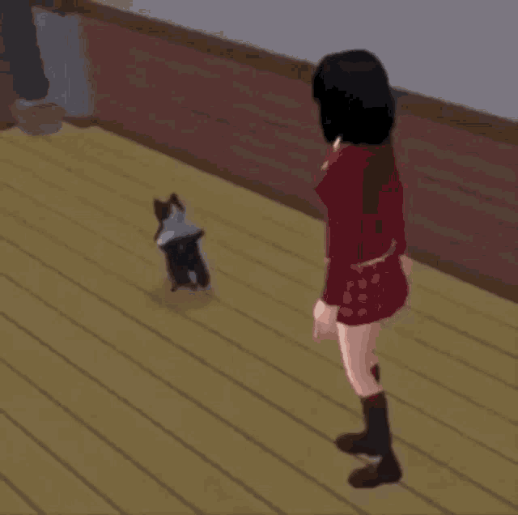
What is DLL Injection?
Writing the path to a DLL
in the virtual address space
of the target process
before loading the DLL
by invoking a new thread.

Slide 14
What is DLL Injection?
Path to a DLL
Virtual address space
Target process
Loading the DLL
Invoking a new thread.

Slide 15

What is DLL Injection?
Path to a DLL
Argument
Virtual address space
VirtualAllocEx, WriteProcessMemory
Target process
Argument
Loading the DLL
GetProcAddress(LoadLibrary)
Invoking a new thread
CreateRemoteThread

Slide 16

Win32API?

Slide 17
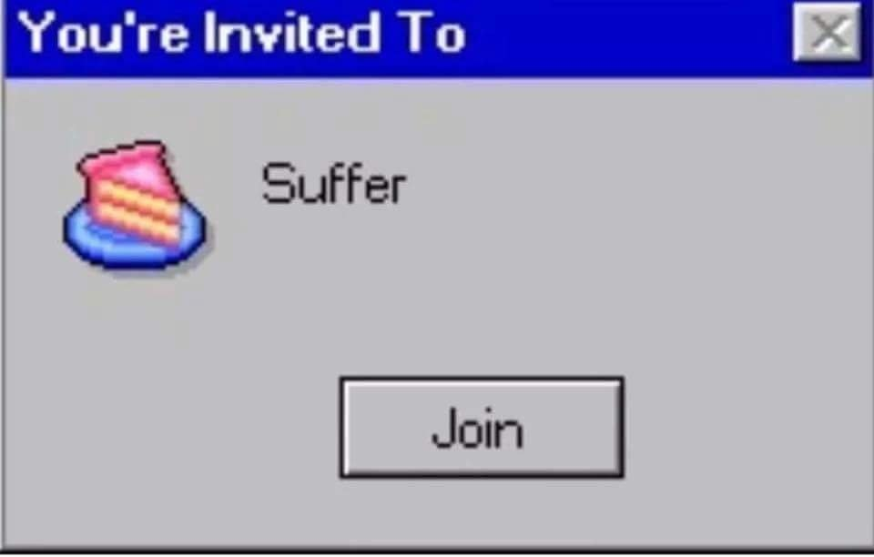
Win32API?

Slide 18

Win32API?
Suffixes
Ex
A/W
Prefixes
Nt
Zw
…And more!

Slide 19
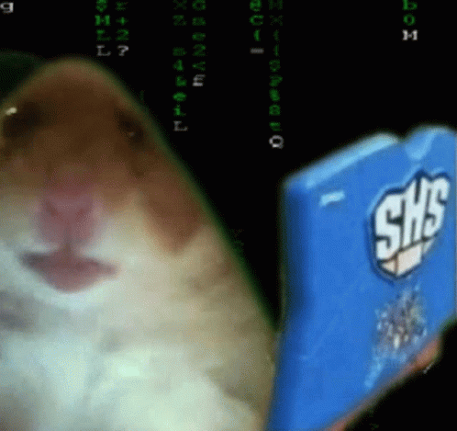
Win32API?
DWORD
Handle
LP / LPVOID

Slide 20
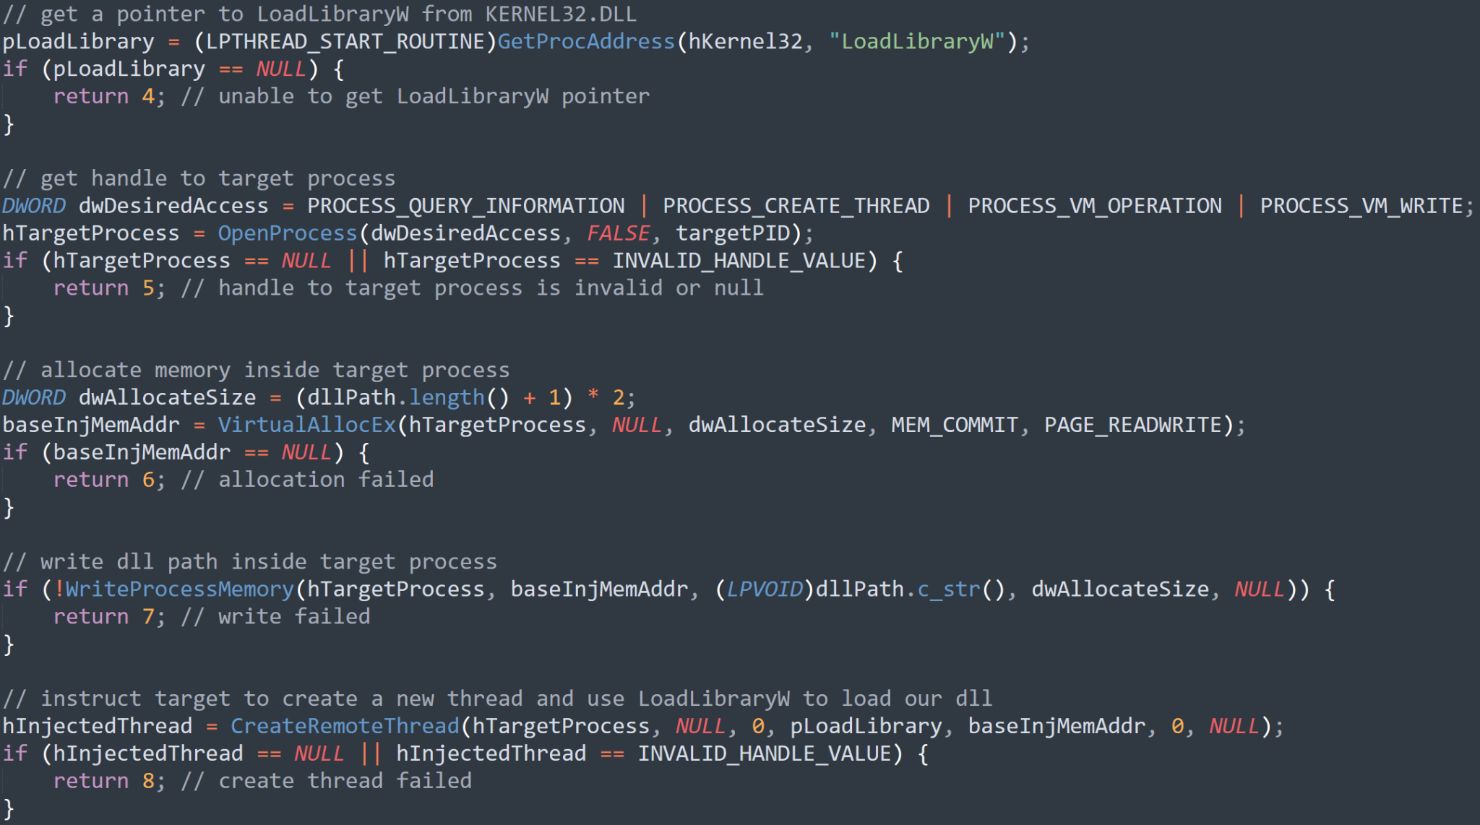

Slide 21

Discussion
Permissions
AV / How to catch?
How to improve?

